Slide 1

Portfolio
Fresh Content Co.

Slide 2
Platform Knowledge
Ecommerce & Website Platforms
  WordPress/WooCommerce
  Shopify/ShopifyPlus
Marketing & Automation
  Flodesk
  Bluecore
  SFMC
  Constant Contact
  Mailchimp
  Attentive
  Meta Business Suite
  SlickText
  Sprout
  Tailwind
  Pinterest Business Manager
SEO & Analytics
  Google Analytics
  Google Search Console
  Semrush
Project Management & Collaboration
  Hive
  Wrike
  Monday.com
  Google Workspace
Core Capabilities
  Ecommerce Website Development
  HTML & CSS Customization
  UX & Customer Journey Optimization
  Conversion-Focused Design
  SEO Strategy & Organic Growth
  Email Marketing Strategy & Execution
  SMS Marketing Campaigns
  Content Writing & Copywriting
  Landing Page Development
  Marketing Automation
  Brand Storytelling & Voice Development
  Audience Research & Engagement Strategy
  Organic Social Media Growth
  Interactive Tool & Resource Development
  Community-Focused Content Strategy
  Mobile-Responsiveness
  Project Management & Creative Coordination

Slide 3
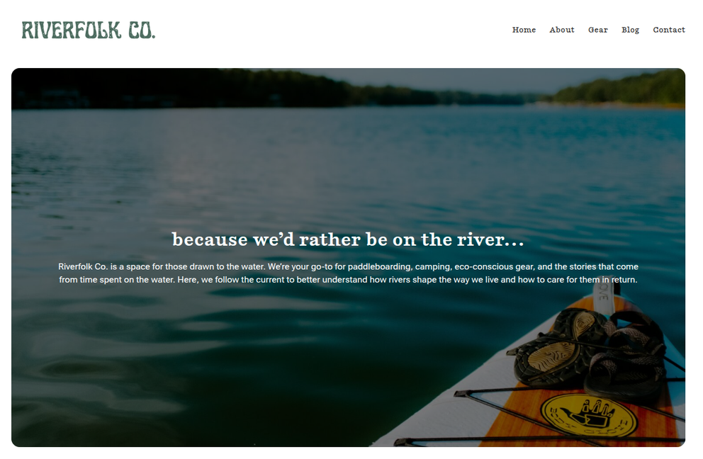
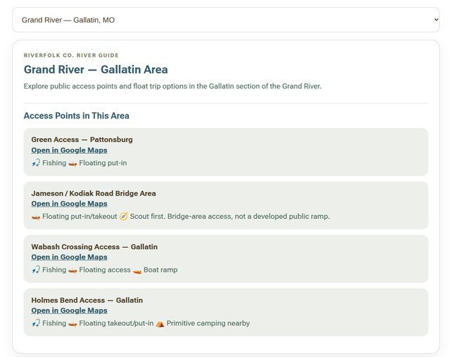
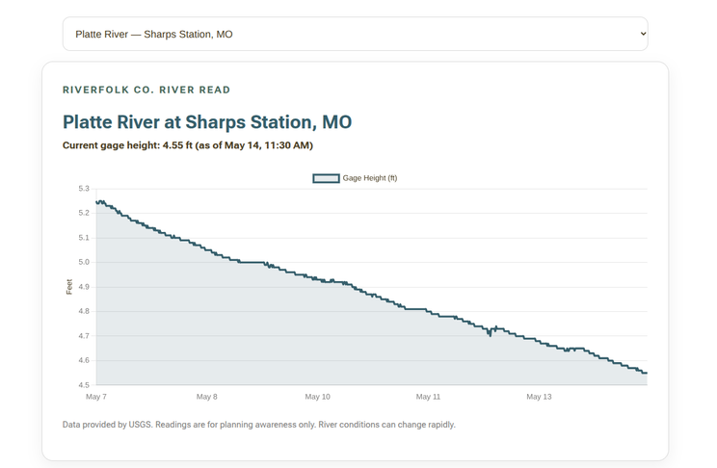
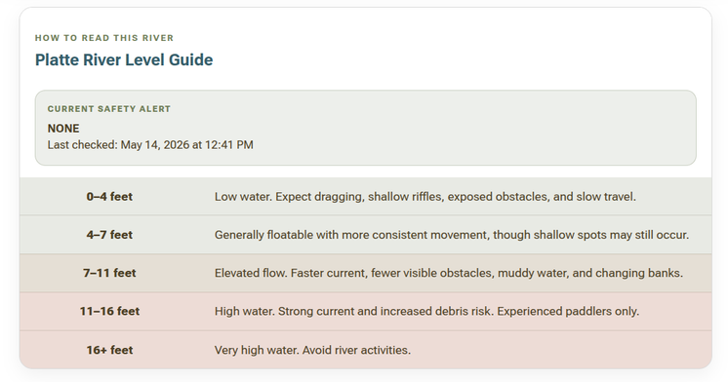
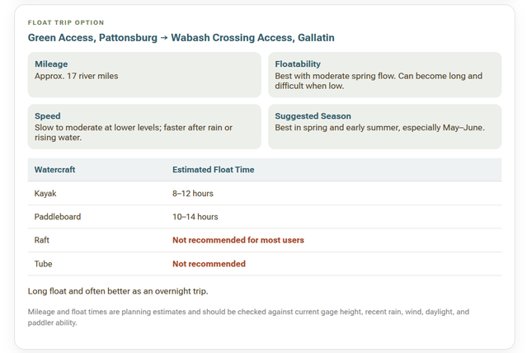
Outdoor Recreation Site Platform Development
Developed an outdoor recreation and river education platform focused on accessibility, trip planning, conservation awareness, and community-driven outdoor content. Built the website and user experience with an emphasis on mobile usability, educational resources, and practical float-planning tools designed to help paddlers safely explore regional rivers.
Created custom interactive float trip systems featuring launch points, mileage estimates, float duration guidance, camping notes, river conditions, and seasonal safety considerations. Integrated live river gauge data and structured informational content to create a more beginner-friendly and data-informed outdoor recreation experience that balances storytelling, education, and practical planning tools.

Slide 4
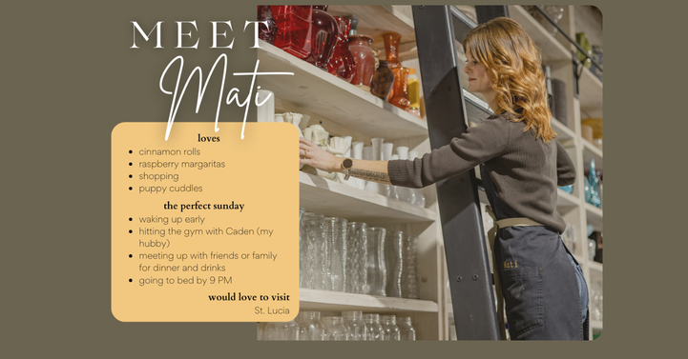
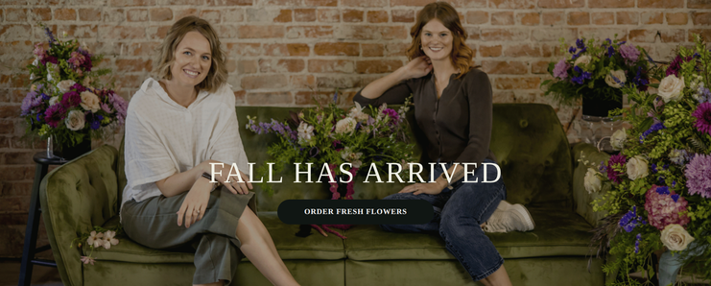
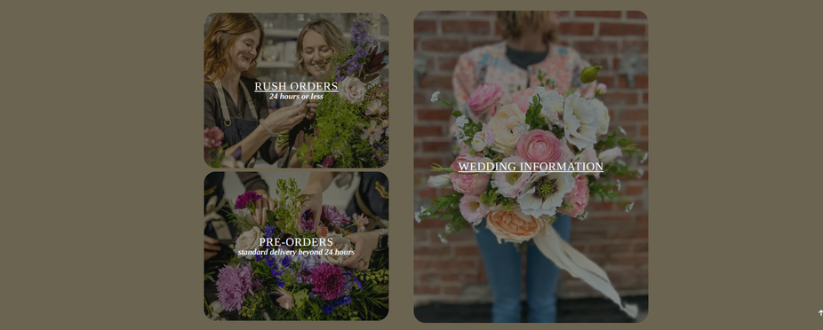
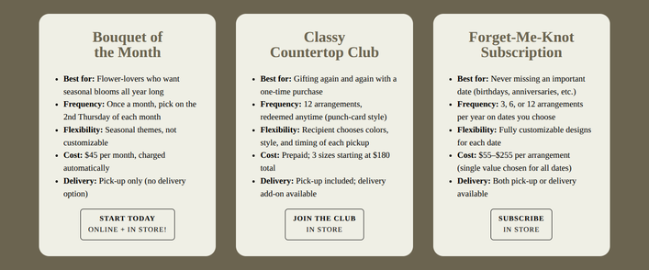
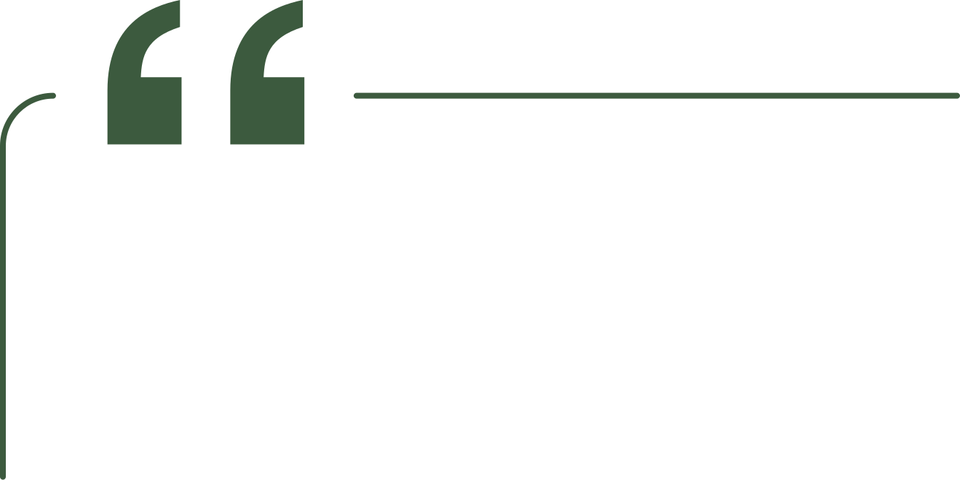
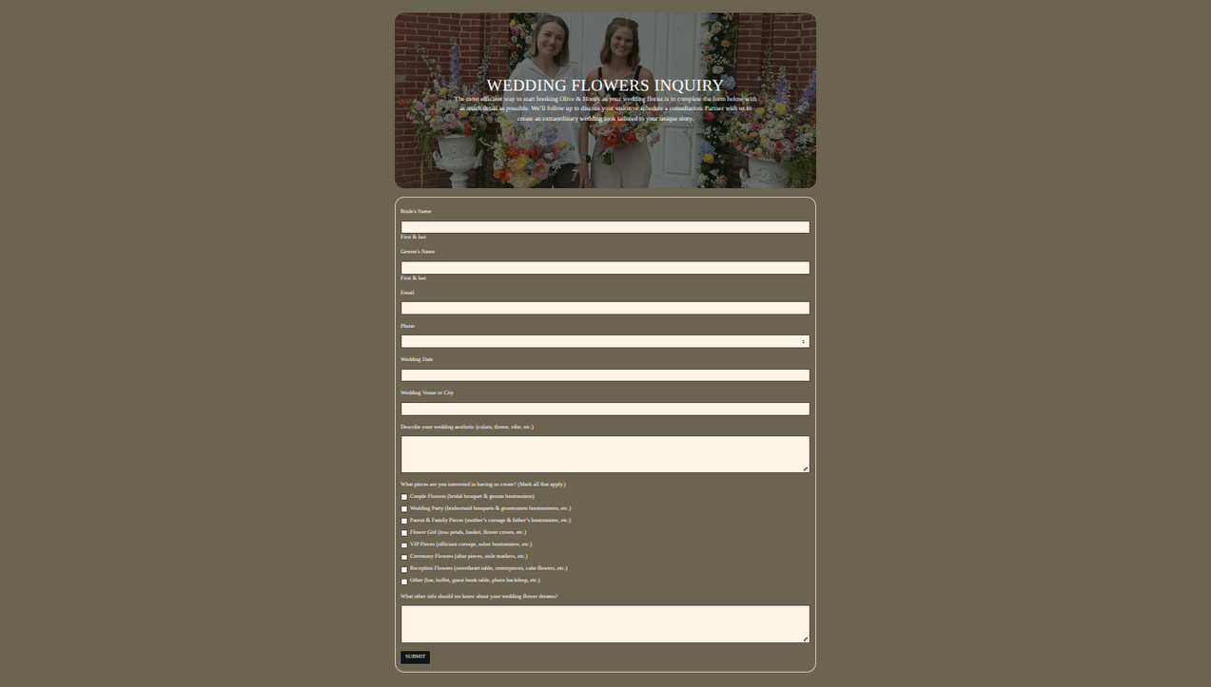
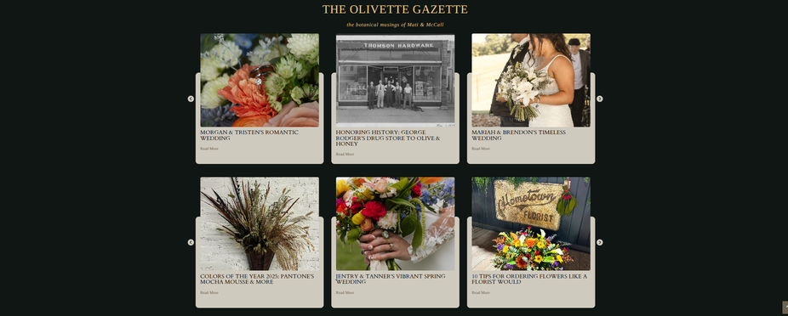
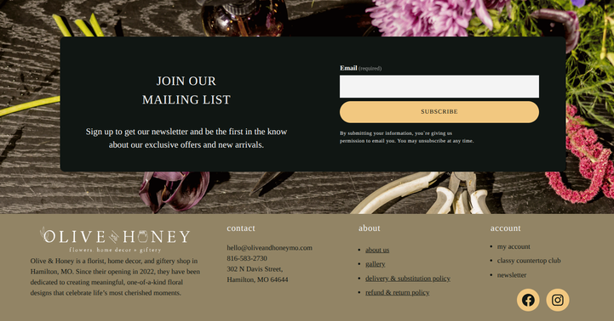
Ecommerce Development & UX
Built and developed an ecommerce website with a strong focus on customer experience, conversion optimization, and streamlined floral ordering workflows. Designed custom checkout systems tailored specifically to subscription products, gifting experiences, and delivery logistics using HTML, CSS, and ecommerce platform customization.
“We have had such a wonderful experience working with Marissa of Fresh Content Co. to create our website for our flower shop, Olive & Honey. She made what could have been an overwhelming process feel easy, organized, and even enjoyable. She was proactive from start to finish, always thinking ahead and offering helpful suggestions that made our website and marketing stronger. At the same time, she really listened to our ideas and feedback, making sure the final result truly reflected our brand. She was reliable with timelines, clear in her communication, and delivered exactly what she promised—beautiful design paired with functionality that actually works for our business. Since launching, we’ve seen a noticeable improvement in how we present ourselves online and connect with customers, and we couldn’t be happier. We highly recommend Fresh Content Co. to anyone looking for someone who is not only talented, but also easy to work with and genuinely invested in your success.”
- McCall & Mati, Owners of Olive & Honey

Slide 5
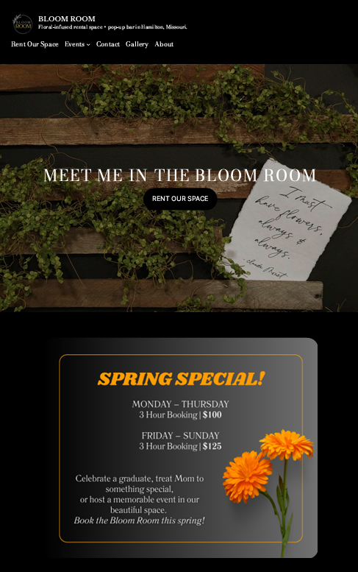

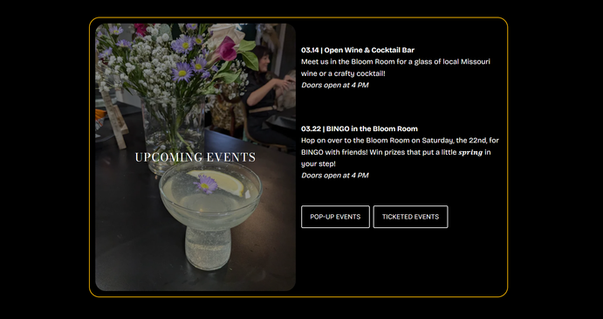
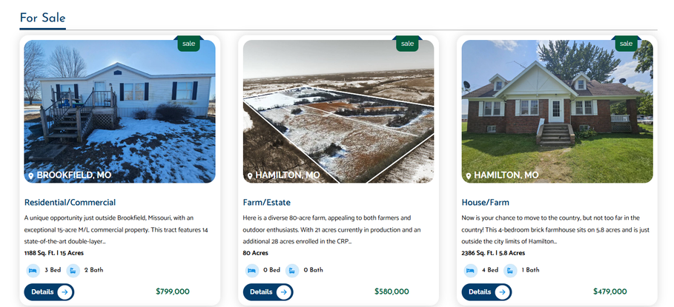
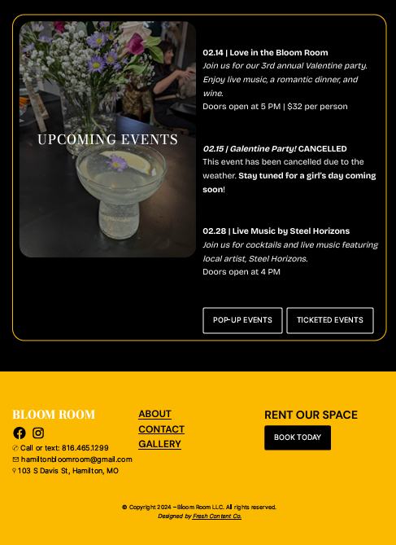
Custom Real Estate Website Build
Developed a custom real estate website focused on usability, lead engagement, and educational SEO content. Built interactive buyer tools and integrated live property listings to create a more dynamic and informative customer experience.
“Marissa designed and maintained my company website. She’s prompt, available, knowledgeable, smart, innovative and just a good, beautiful human. The kind of person you want to help reach your professional goals! So appreciative of her.”
- Deanna, Owner of the Bloom Room
Event Space + Pop-Up Bar Web Development
Developed a clean, informational web experience for a multi-use event space and pop-up bar concept, focused on accessibility, event visibility, and cohesive brand presentation. Built custom branded styling elements using HTML and CSS to create a polished, immersive customer experience.

Slide 6
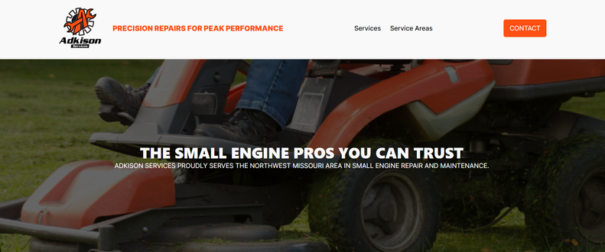
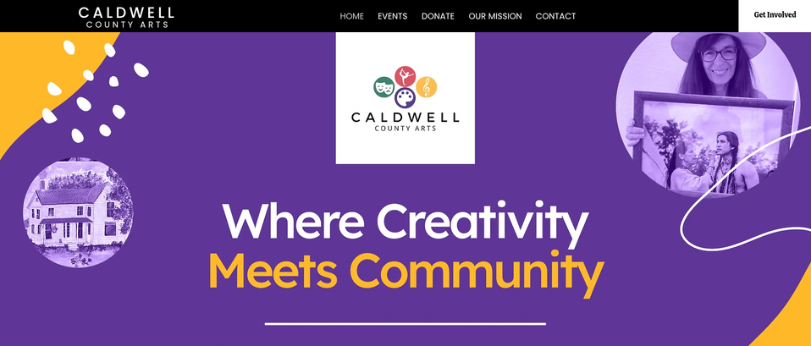

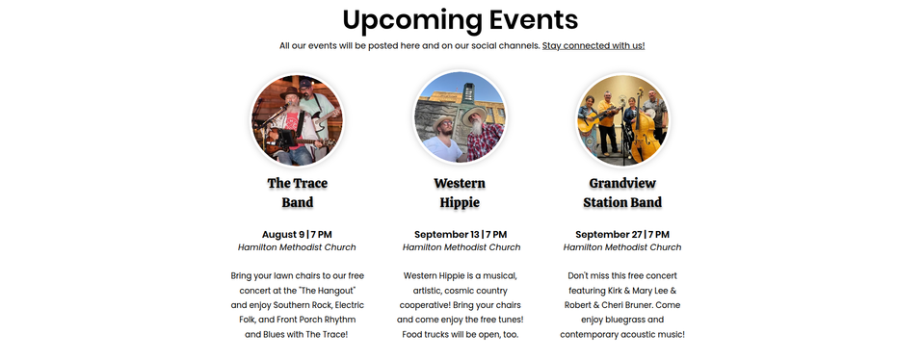
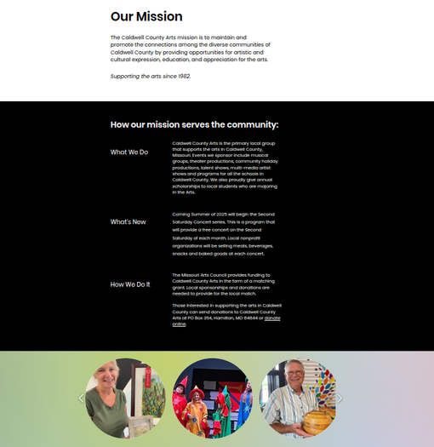


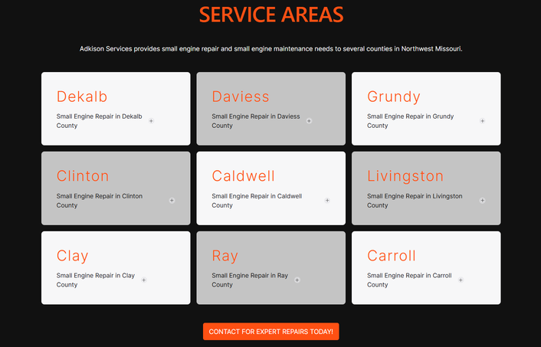
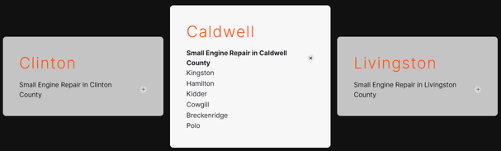
Small Engine Repair
Website Development
Developed a clean, informational website focused on accessibility, clarity, and local business visibility. Built within custom branded styling through HTML and CSS to create a polished, easy-to-navigate customer experience.
“Marissa is thorough and creative. When we have questions, she responds quickly. I can recommend her services to anyone who needs someone to create and maintain a website. Communication is key! She will talk you through the process. We often ask for her help in reaching our audience. We are grateful for her services.“
- Debby, Board Member of Caldwell County Arts Association
Non-Profit Website Development
Developed an informational nonprofit website focused on community engagement, event awareness, and supporter accessibility. Built with an emphasis on clear navigation, approachable design, and mission-driven storytelling.

Slide 7
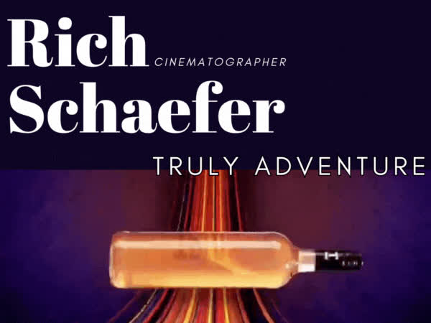
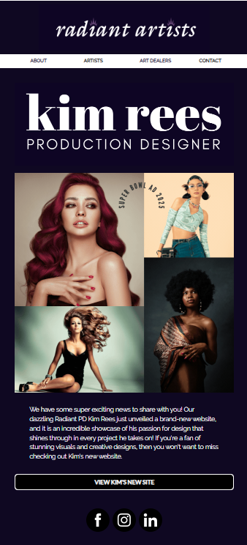
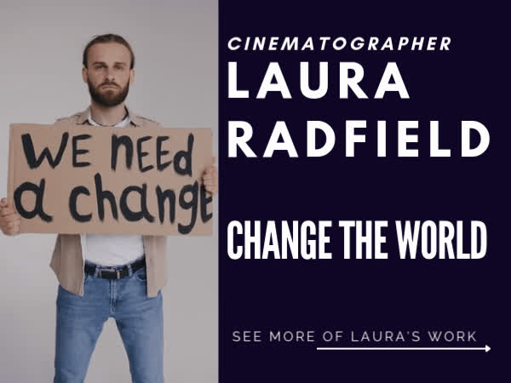
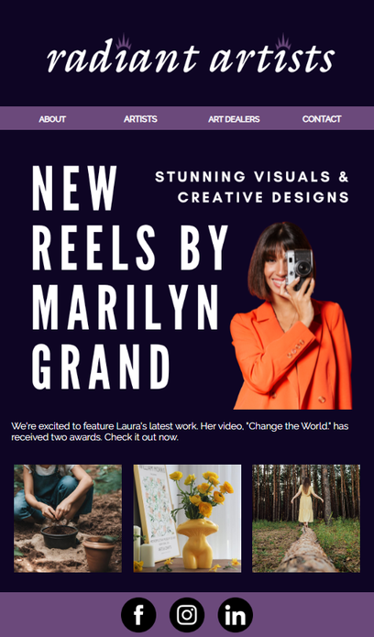
Email Template Design | Talent Agency
Designed a custom email marketing template for a talent agency with a modern, editorial-inspired aesthetic focused on movement, visual hierarchy, and brand consistency. Reworked video content for email-friendly formatting while creating a bold, magazine-style experience aligned with the client’s creative direction.
“Enthusiastically recommend you work with Marissa! She was clear, proactive, and on time/on budget. Super appreciate that she made our time together so productive and enjoyable.”
- Marilyn, Marketing Manager at Radiant Artists

Slide 8
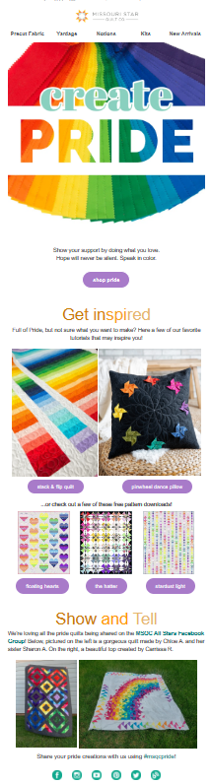
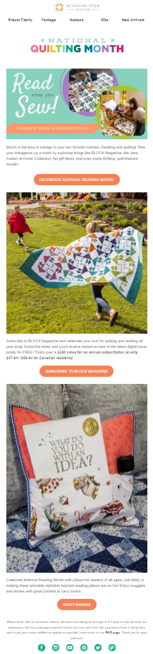
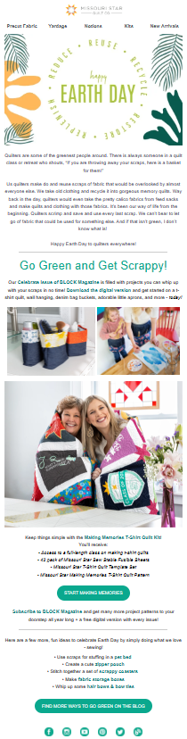
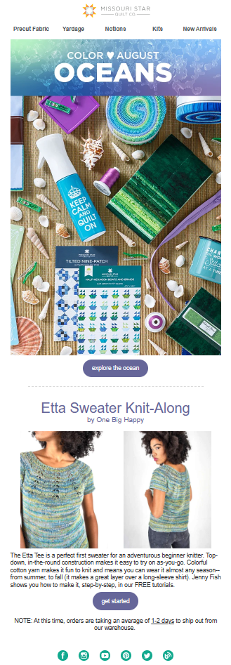
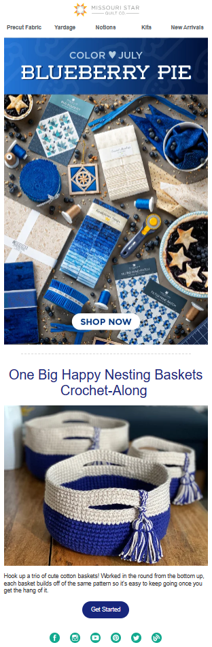
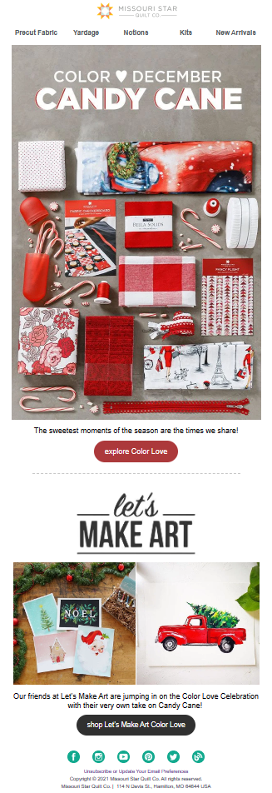
Email Campaign Strategy & Execution | Textile & Crafting Industry
Led strategy, creative development, and execution for large-scale seasonal and community-driven email marketing campaigns, including the Color Love campaign, Pride Month, National Quilting Month, and Reading Month initiatives. Managed campaigns from concept through launch while balancing brand storytelling, audience engagement, and conversion-focused marketing.

Slide 9
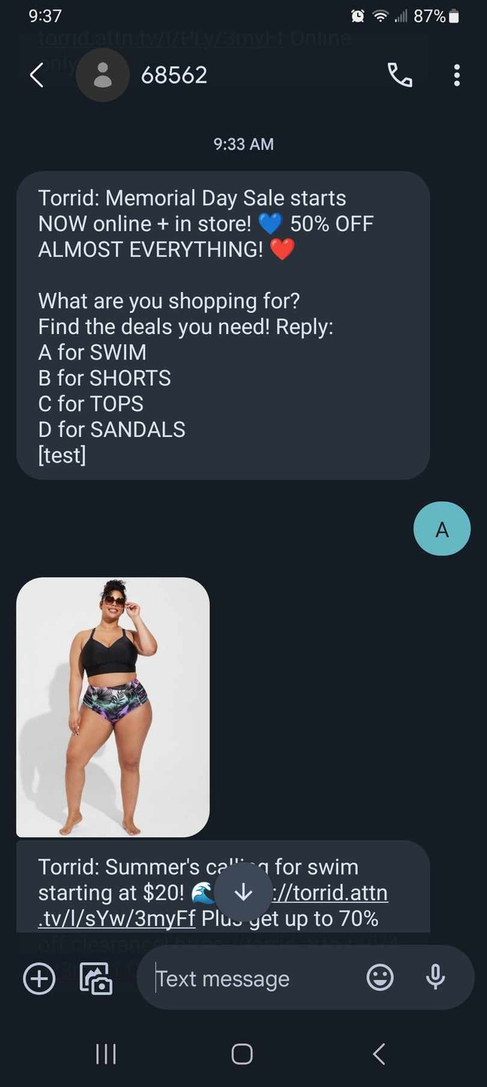
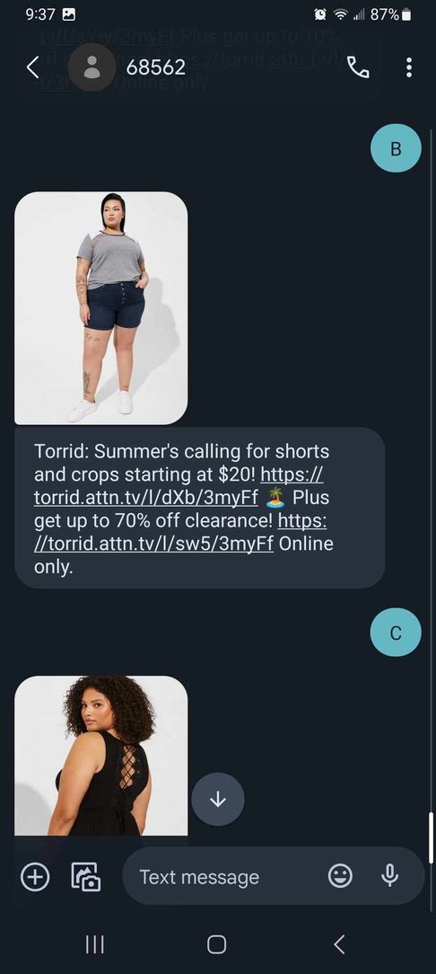
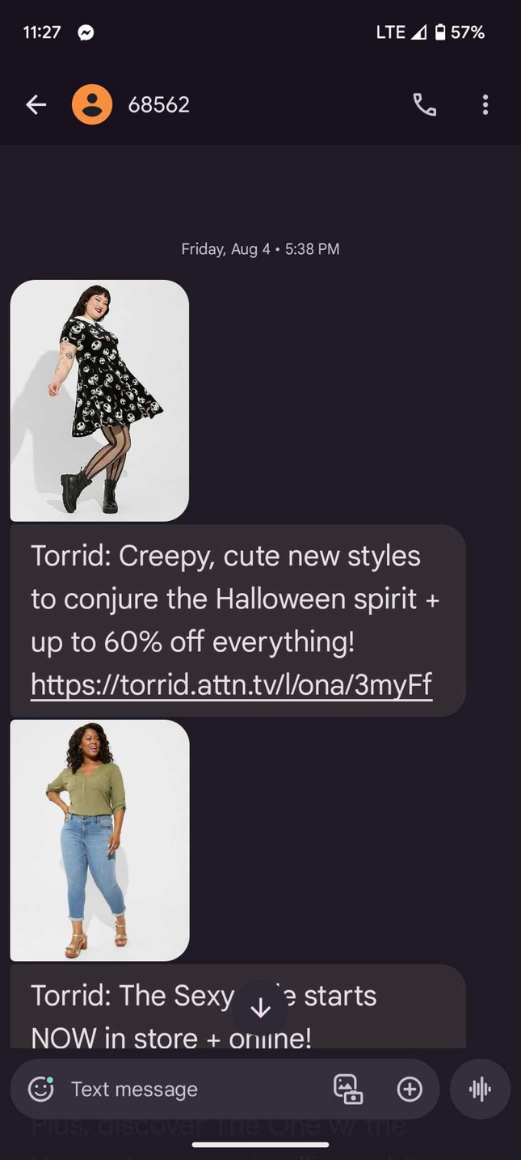
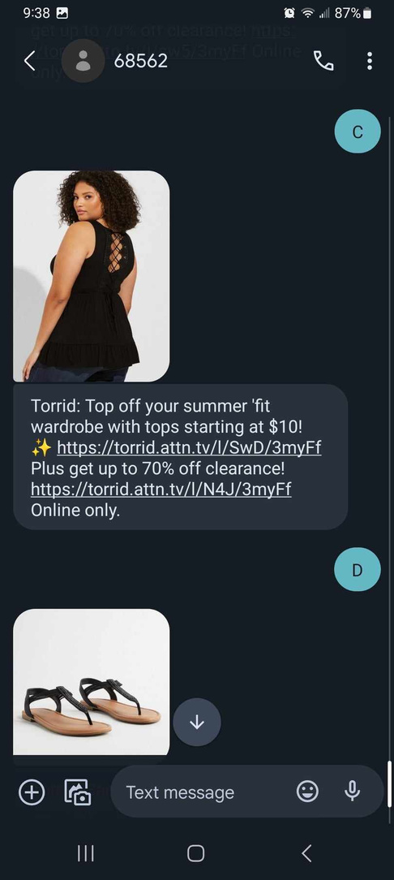
SMS Campaign Strategy & Execution | Fashion Industry
Developed and executed high-impact SMS marketing campaigns designed to increase engagement, drive conversions, maintain strong brand personality across mobile-first customer touchpoints, and created more conversational customer interactions through keyword-based reply strategies and two-way mobile engagement.
GROUNDHOG DAY
SHADOW
"Up to 70% off EVERYTHING online is ENDING (wish we were saying goodbye to winter instead)."
No Shadow
"Up to 70% off EVERYTHING online is ENDING (as is winter!). Grab this deal b4 it retreats back to the burrow."

Slide 10
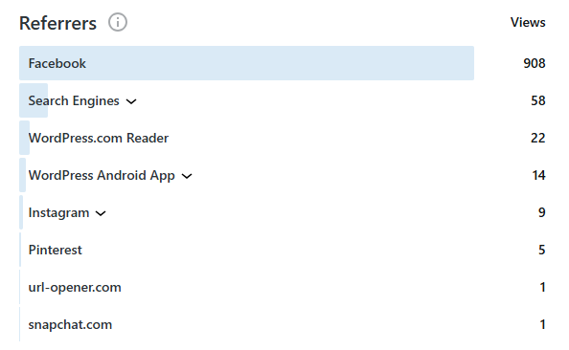
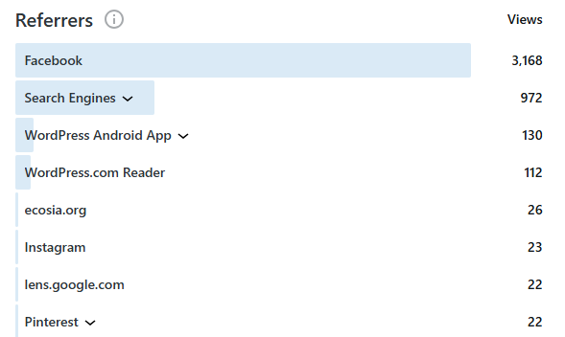
Before SEO optimization
SEO Optimization (Organic Growth) | Content Creator Blog
Led a full organic SEO optimization initiative focused on improving search visibility, indexing performance, and overall user experience for a content creator blog. Conducted in-depth keyword research to target high-relevance search terms, optimized URL structure for stronger indexing performance, and refined metadata, alt text, and page structure to improve both accessibility and search visibility. Enhanced layout readability and developed image-rich, search-focused content designed to support stronger organic rankings and user engagement.
6 Months After
Results
  Increased search engine impressions from 58 to 972 within 6 months
  Achieved approximately +1,500% growth in organic search impressions

Slide 11
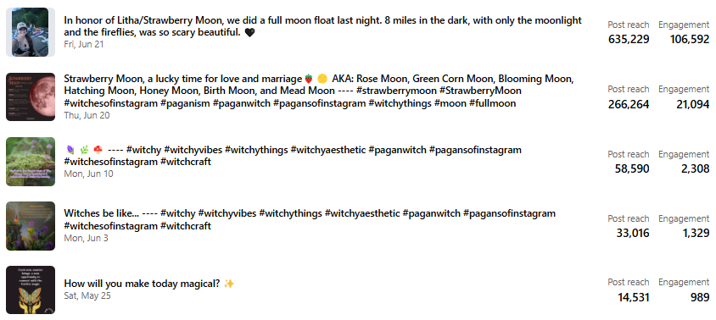

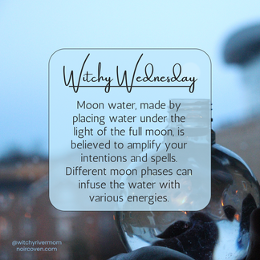

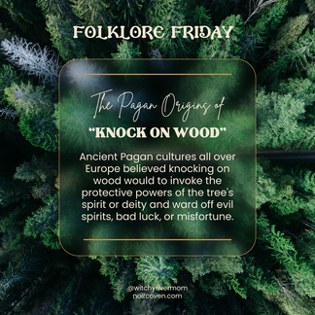
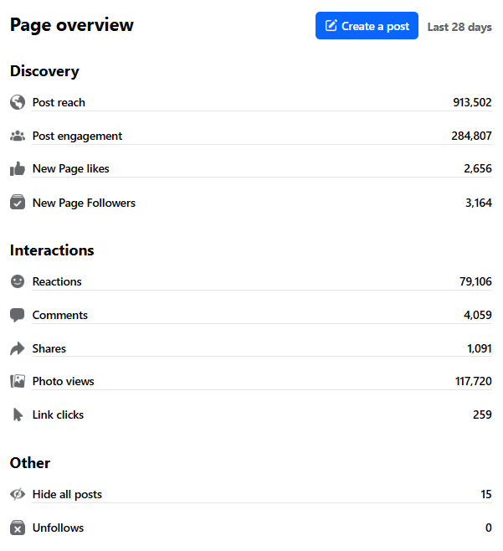

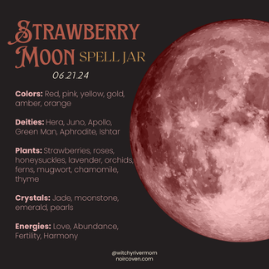

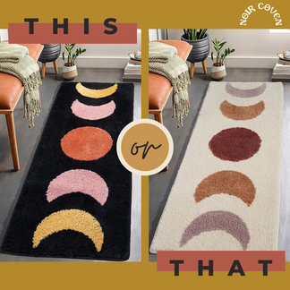

75 reactions
0 comments
6 shares
Social Growth (Organic) | Content Creator Blog
Developed and executed an organic social media growth strategy focused on visibility, engagement, audience retention, and community building for a content creator blog. Conducted hashtag and keyword research to improve discoverability while creating relevant, strategically designed content paired with engagement-focused copywriting. Managed community interaction and implemented timing and posting cadence strategies designed to maximize reach and audience responsiveness.
78 reactions
8 comments
25 shares
372 reactions
47 comments
1.6k shares
56 reactions
41 comments
0 shares
Results
Within a 28-day period, the account reached 913,502 users, generated 284,807 engagements, and gained 3,164 new followers organically.

Slide 12
Blog Intro | Textile & Crafting Industry
Content: Freebie DIY Pattern Giveaway
Goal: Increase Engagement during COVID
Social Post | Outdoor Content Creator
Content: National Bear Day
Goal: Promote recent blog post
“Use it up... Wear it out... Make it do... Or do without”
Jenny is a resourceful gal. With seven kids and a tight budget, she perfected the art of frugality.
From the hardships of the Oregon Trail to the poverty of the Great Depression, quilters have always found ways to make something out of nothing...
Bears remind us that not everything exists for human convenience.
If the river had a guardian spirit, I think it would look a lot like a bear.
And that’s worth honoring.
Her bare feet make impressions woven among the tall grass, leaving soft splotches of velvet as she walks. With each step is an illuminating glow of crimsons and teals. They last but for a moment just as the rings that quickly disappear from stones skipping across a river. The slower she walks, the more intense the vibrations - an earthly zing coursing through her veins.
The moon, an enigmatic companion, whispers. Beautiful, soft words in a language she cannot speak, but as she closes her eyes, it's message becomes clear – a tale meant only for her. The sun will make her forget the words though. Its light will impose on the night, taking away the crimsons and teals, and the vibrations will stop as the world wakes to create chaos, disturbing her tiny waves of peace. “Shh...” she murmurs softly to the moon. Her heart embraces its words, while her mind, less resilient, struggles to bear them.
As she opens her eyes, the tree line pirouettes, coalescing into a labyrinth of black branches against a hazy grey backdrop. A cozy cove beckons, extending an invitation with gentle, rhythmic sways. Across the field she dashes, her speed transforming velvet splotches into sprawling pools of light that splatter like paint beneath her feet. Yet, upon reaching the woods, a disappointing stillness prevails. The haze retreats into the forest, and the blackness yields to hues of emerald and rust. She focused on a single leaf. “Dance,” she shouted! And the emerald specks began to shimmer.
Creative Writing Sample (Unpublished)
Content: Creative Writing
Goal: For fun

Slide 13
Thank You

